Slide 1
Prosthetic Database
Group 01:
Gabriela Apicella
Jaime Bermejo
Marina Miguélez
Maria Celeste Ortega

Slide 2







What is the purpose of our Database?
Users:
Doctors
Patients
Biomedical Engineers
Hospitals
Huge interconnect stock network where the main target is to find the better prosthetic to the patient, helped by the Doctor.

Slide 3
E-R DIAGRAM
PATIENT
DOCTOR
HOSPITAL
BIOMEDICAL ENGINEER
PROSTHETIC

Slide 4

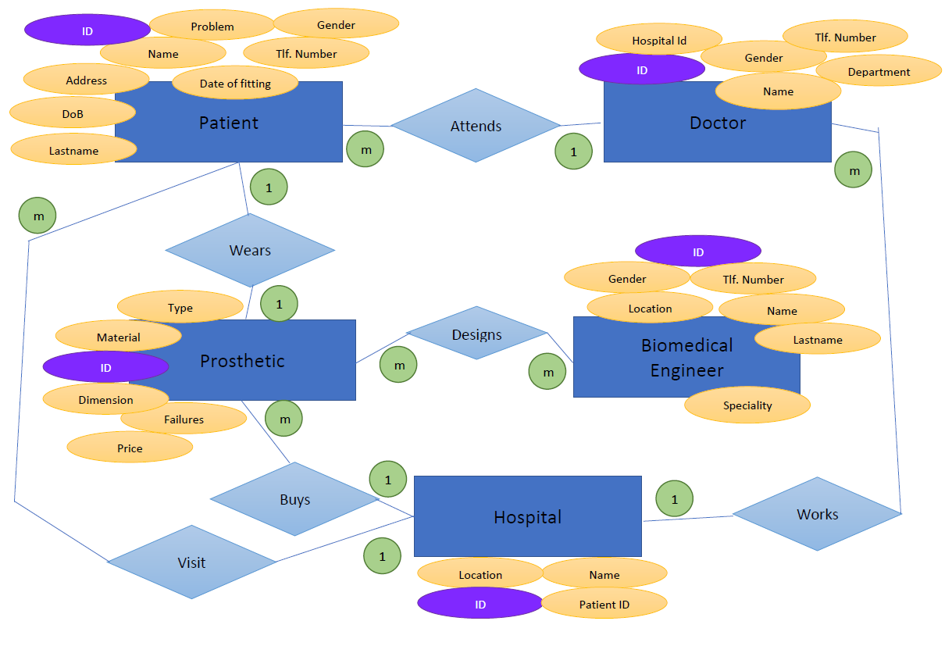

Slide 5
PATIENT
Name
Last name
ID
Date of birth
Gender
Address
Telephone number
Problem
Date of fitting
HOSPITAL
VISIT
1
m
PATIENT
WEARS
PROSTHETIC
m
1
1
ATTENDS
DOCTOR
1

Slide 6
DOCTOR
Name
ID
Gender
Tlf. number
Hospital ID
Department
DOCTOR
HOSPITAL
WORKS IN
m
1

Slide 7
HOSPITAL
Name
ID
Location
Patient ID
HOSPITAL
BUYS
PROSTHETIC
1
1

Slide 8
BIOMEDICAL ENGINEER
Name
Lastname
ID
Gender
Tlf. number
Location
Speciality
BIOMEDICAL ENGINEER
DESIGNS
PROSTHETIC
m
m

Slide 9
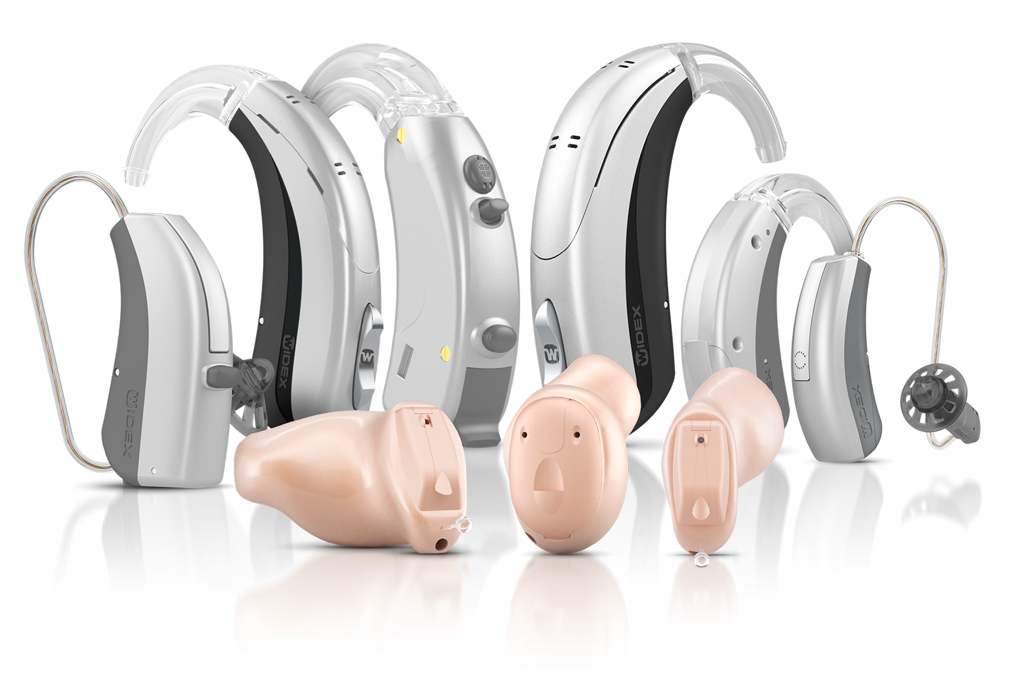
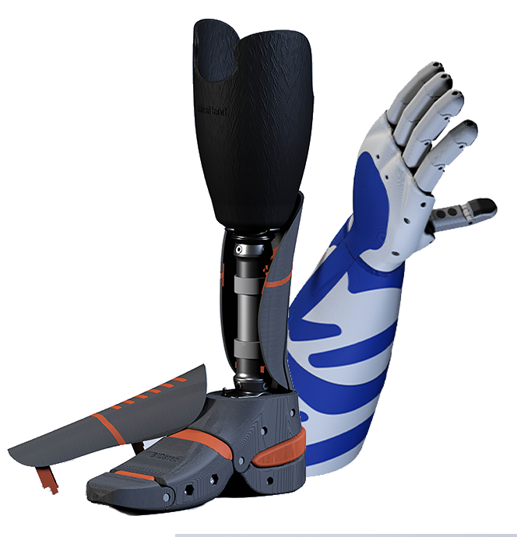
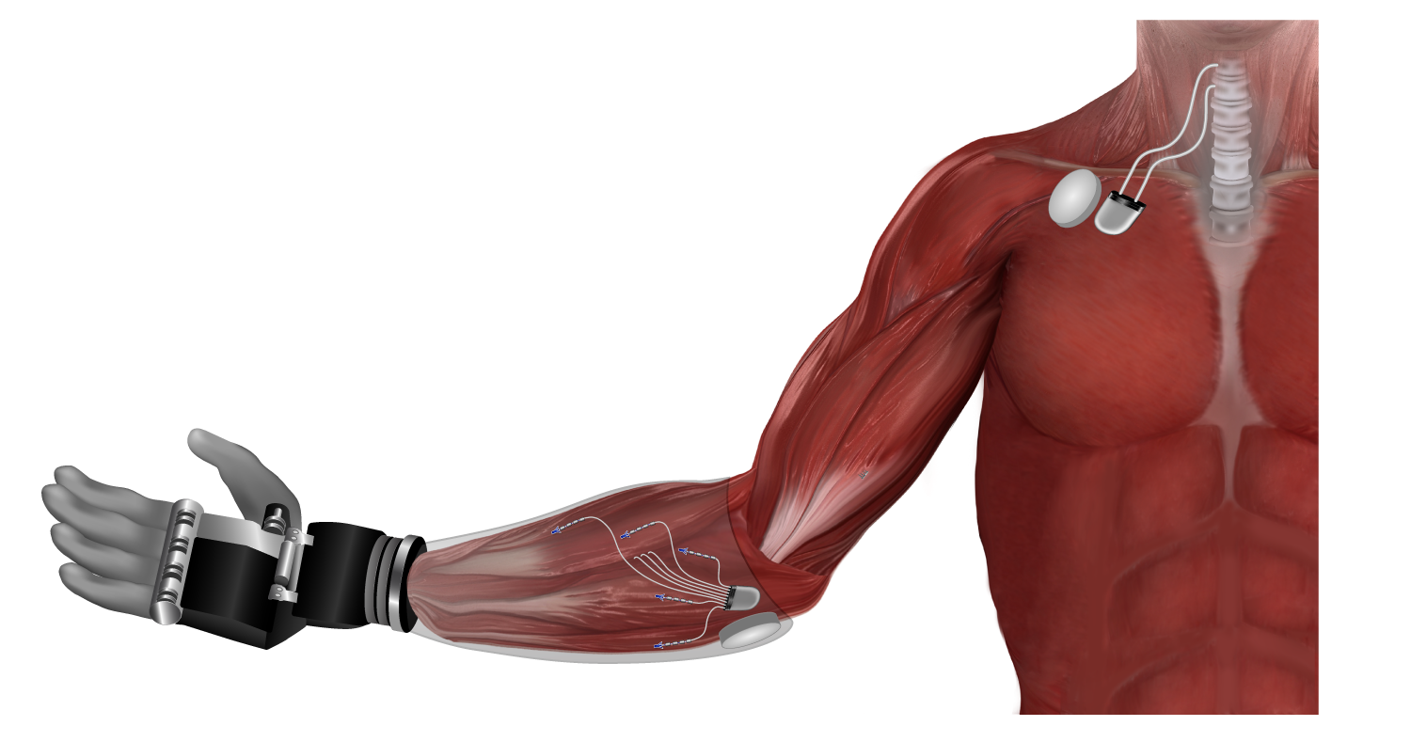
PROSTHETIC
ID
Type
Material
Dimensions
Failures
Price

Slide 10
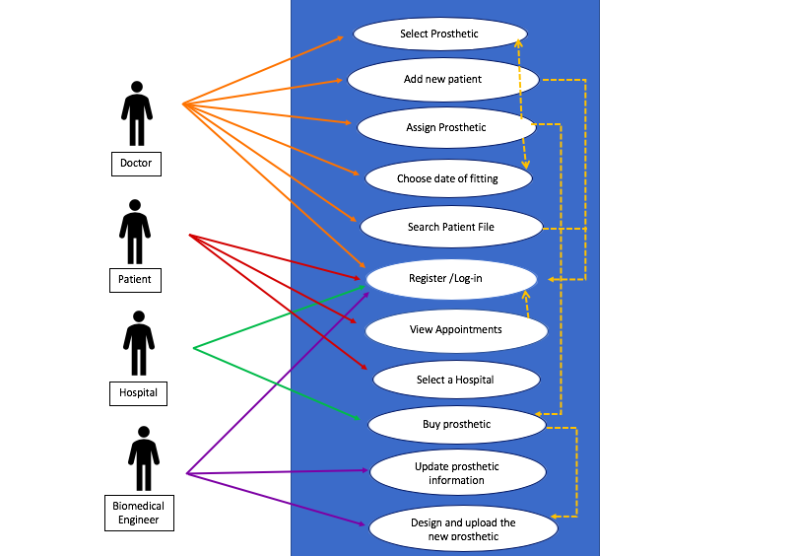
Use-Case Diagram

Slide 11
mock-ups
mock-ups

Slide 12
MAIN MENU
MAIN MENU
PATIENT
DOCTOR
HOSPITAL
BIOMEDICAL ENGINEER

Slide 13
PATIENTS MENU
Register / Log-In
Select a hospital
View appointments

Slide 14
PATIENTS MENU
REGISTER
Name
Last Name
Telephone
Password
LOG-IN
Telephone
Password

Slide 15
PATIENTS MENU
Register / Log-In
Select a Hospital
View appointments
Type the name of the hospital...

Slide 16
PATIENTS MENU
Register / Log-In
Select a hospital
View appointments
Click to see the calendar with your appointments

Slide 17
MAIN MENU
MAIN MENU
PATIENT
DOCTOR
HOSPITAL
BIOMEDICAL ENGINEER

Slide 18
DOCTOR MENU
Register / Log-In
Add/Modify/Delete patient
Select a Prosthetic
Select date of fitting
Search patient´s file

Slide 19
DOCTOR MENU
REGISTER
Name
Last Name
Telephone
Password
LOG-IN
Telephone
Password

Slide 20
DOCTOR MENU
Register / Log-In
Add/Modify/Delete patient
Select a Prosthetic
Date of fitting
Search a patients file

Slide 21
ADD PATIENT
Name
Lastname
Date of Birth
Address
Telephone
Gender
Problem

Slide 22
DOCTOR MENU
Register / Log-In
Add/Modify/Delete patient
Select a Prosthetic
Date of fitting
Search a patients file

Slide 23
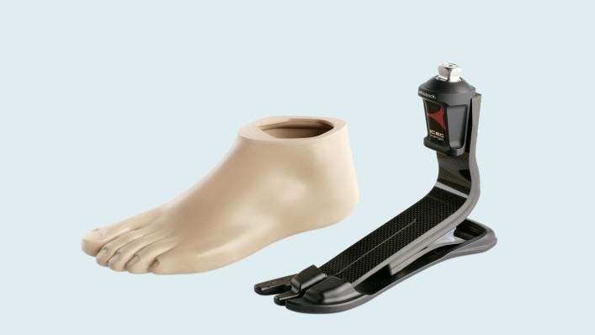
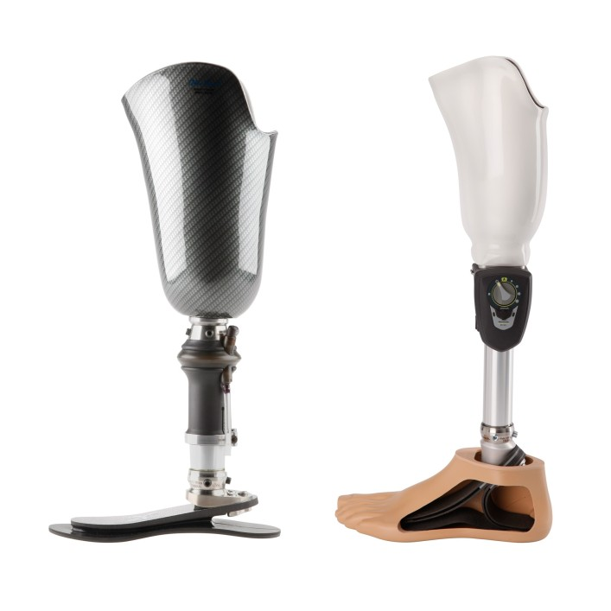
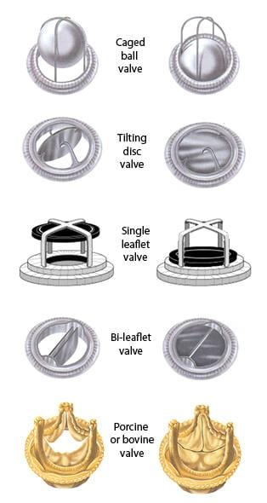
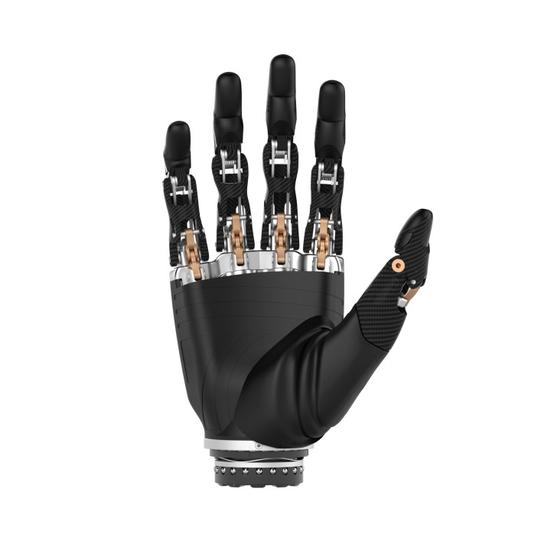
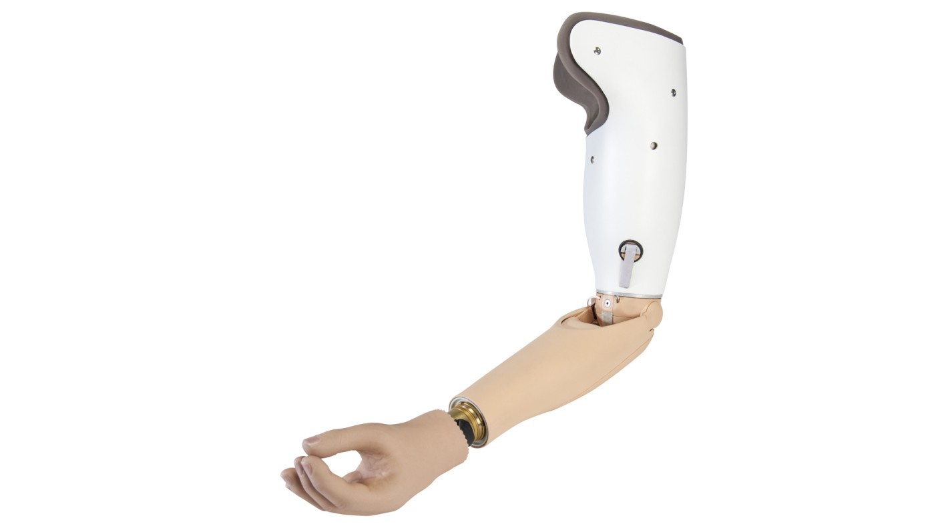
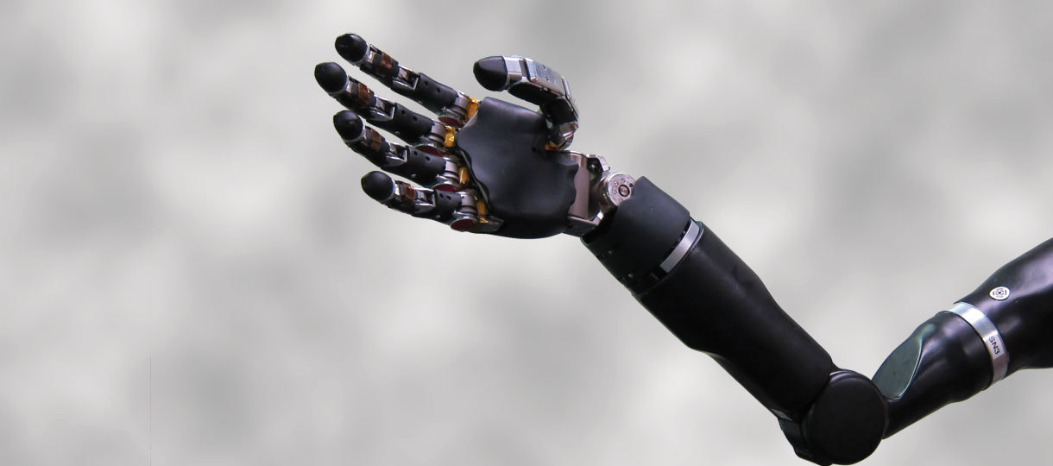
SELECT A PROSTHETIC
List of the Hospital´s available prosthetics

Slide 24
DOCTOR MENU
Register / Log-In
Add/Modify/Delete patient
Select a Prosthetic
Date of fitting
Search a patients file

Slide 25
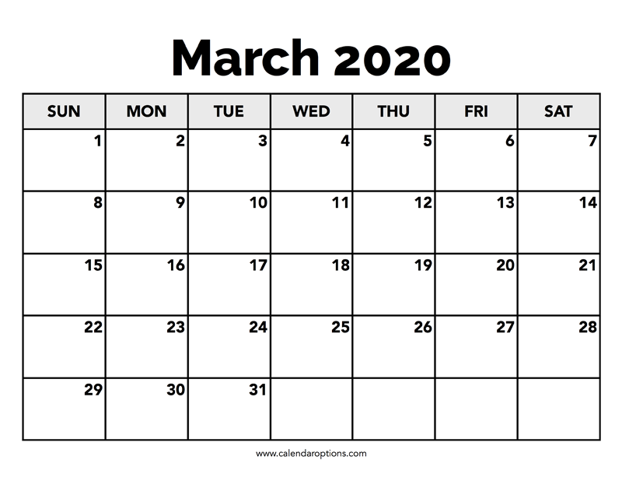
DATE OF FITTING
BOOK FITTING DATE

Slide 26
DOCTOR MENU
Register / Log-In
Add/Modify/Delete patient
Select a Prosthetic
Date of fitting
Search a patients file
Write the patient´s telephone....

Slide 27
MAIN MENU
MAIN MENU
PATIENT
DOCTOR
HOSPITAL
BIOMEDICAL ENGINEER

Slide 28
HOSPITAL MENU
Register / Log-in
Buy Prosthetic

Slide 29
HOSPITAL MENU
REGISTER
Name
Location (City)
Telephone
Password
LOG-IN
Telephone
Password

Slide 30
HOSPITAL MENU
Register / Log-in
Buy Prosthetic

Slide 31
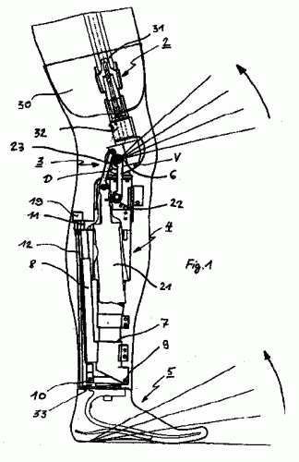
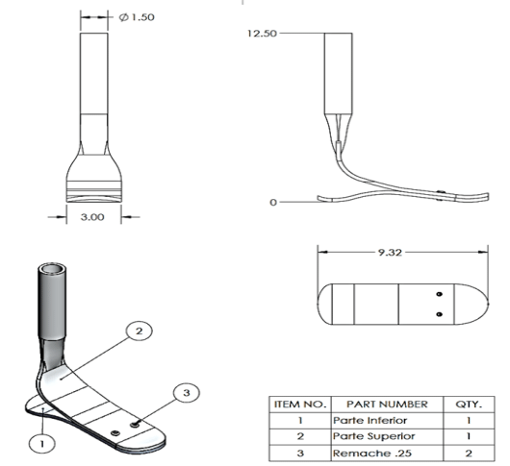
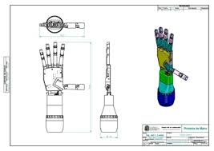
BUY PROSTHETIC
List of Prototypes
Design 1
Design 2

Slide 32
MAIN MENU
MAIN MENU
PATIENT
DOCTOR
HOSPITAL
BIOMEDICAL ENGINEER

Slide 33
BIOMEDICAL ENGINEER MENU
Register / Log-In
Add/Modify/Delete prosthetic

Slide 34
BIOMEDICAL ENGINEER MENU
REGISTER
Name
Last name
Telephone
Password
LOG-IN
Telephone
Password

Slide 35
BIOMEDICAL ENGINEER MENU
Register / Log-In
Add/Modify/Delete prosthetic

Slide 36
ADD PROSTHETIC INFORMATION
Type
Material
Dimensions
Failures
Price

Slide 37
CONCLUSIONS

Slide 38
QUESTIONS
? ? ?

Slide 39
Bye, have a good day
👨🏻‍💻 👩🏼‍💻 👩🏽‍💻 👩🏻‍💻
🦾 🦿

